Slide 1
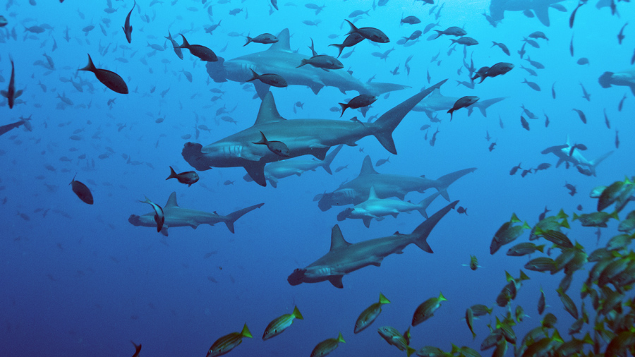
Neuroscience of social behaviour: introduction 2
Dr Will Norton: whjn1@le.ac.uk
Neuromodulation of social behaviour: endothelin signalling

Slide 2
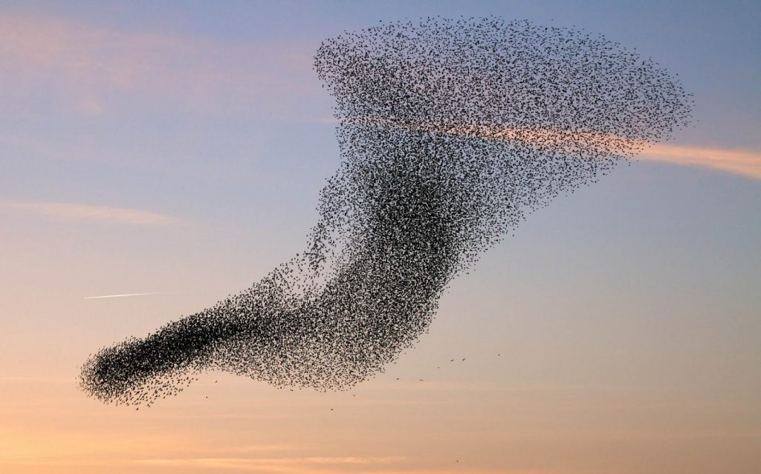
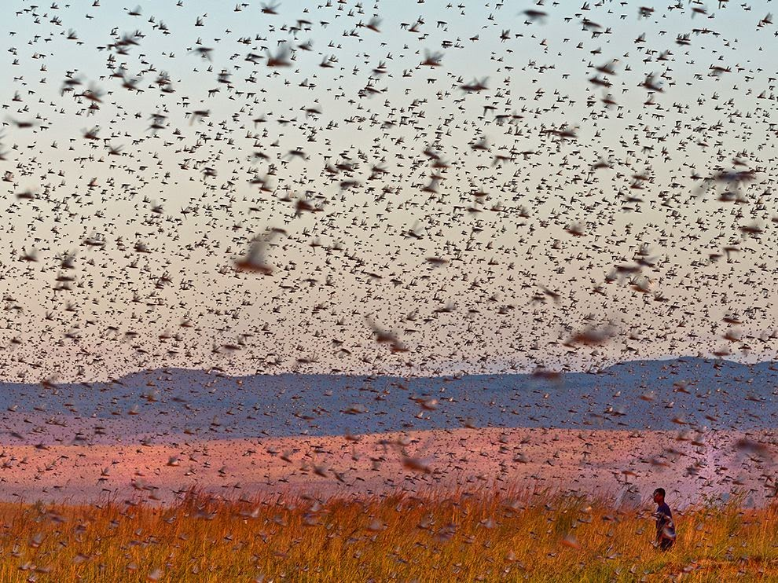
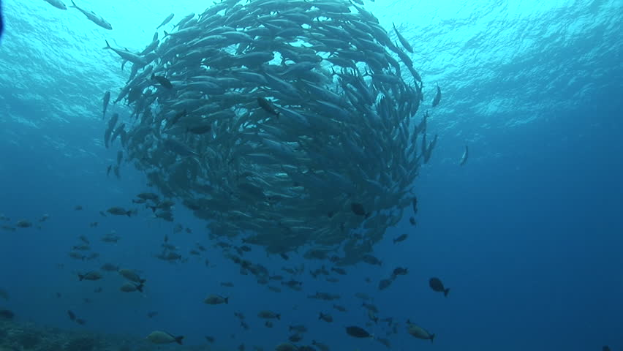

Social behaviour
Collection of images showing social behaviour in different animal species

Slide 3

Aggression levels can determine level of social interactions
Social interactions represent a trade-off for animals balancing the costs
and benefits of proximity
Closer interactions provide protection from predators, more efficient
foraging, social learning and information transfer
Decreases amount of food that each animal will receive; increases
aggression and kleptoparasitism
Krause and Ruxton 2002
A gull stealing food from a flamingo
Notes:
Studies suggest that leaders are not really needed to polarise a school – see Krause papers

Slide 4
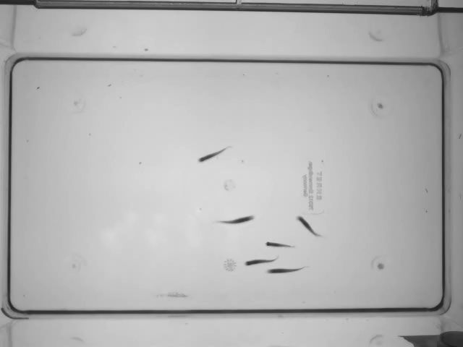
Zebrafish social behaviour: shoaling
A film of six wild-type zebrafish shoaling

Slide 5
The social decision making network (SDM)
Controls social behaviour in the vertebrate brain and is conserved
across different species
Interacts with the
mesolimbic reward
system to control
reaction to salient
stimuli
Network of connections between the reward pathway
and social decision making network
O’Connell and Hoffmann 2012

Slide 6
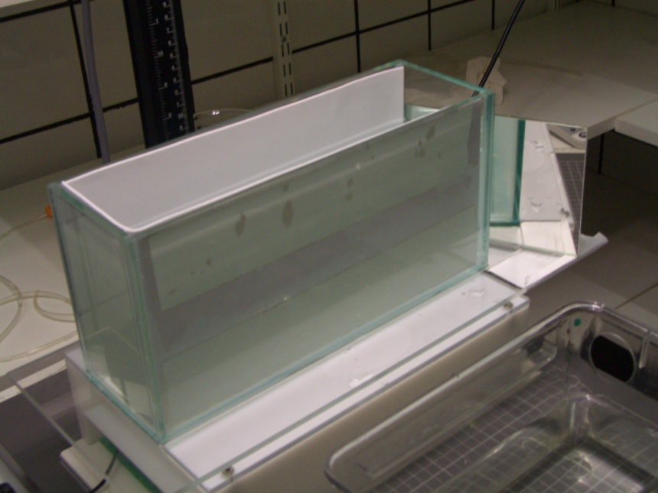
parade mutants are more aggressive than wild-type
Photo of aggression setup
Graph showing aggression between wild-type and ednraa mutants
What about other related behaviours (anxiety, social behaviour)?
Notes:
Can say that it does not recapitulate all aspects of aggression, or keep that for the question session
Why is this phenotype opposite to the one in mouse?

Slide 7
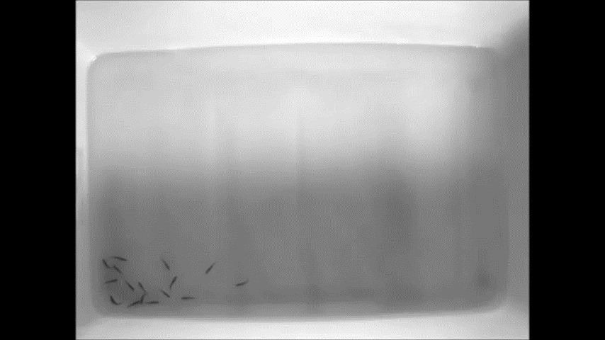
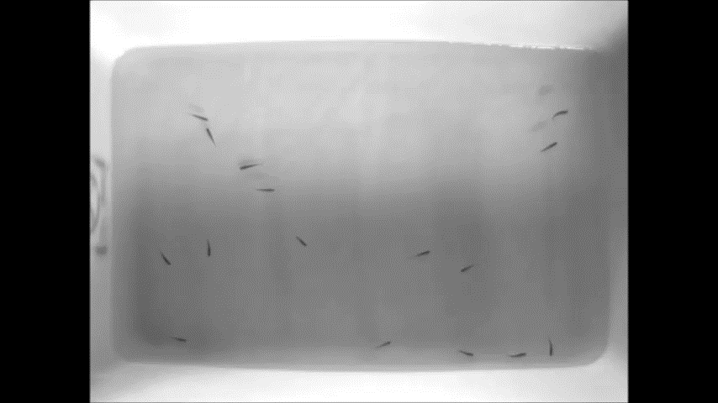
ednraa show increased social spacing
Films showing decreased shoaling in ednraa mutants compared to wild-type
AB wild-type control fish
ednraa mutant fish
Social behaviour of a group of 16 fish in large tank (80 x 40 cm)

Slide 8
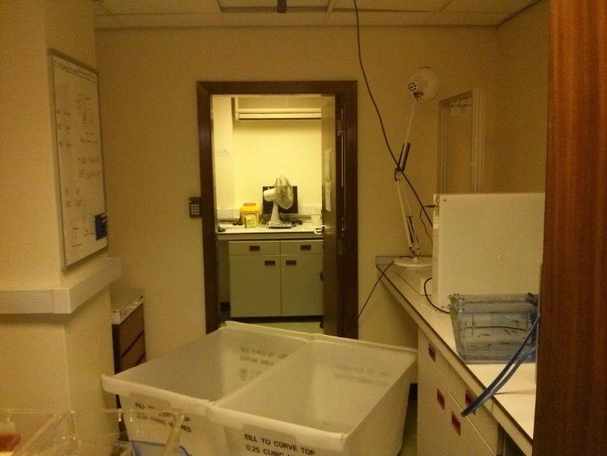
Social spacing in a large tank
Graphs showing decreased social behaviour
in ednraa compared to wt
Social behaviour in large tank (80 x 40 cm)
NND
IID

Slide 9

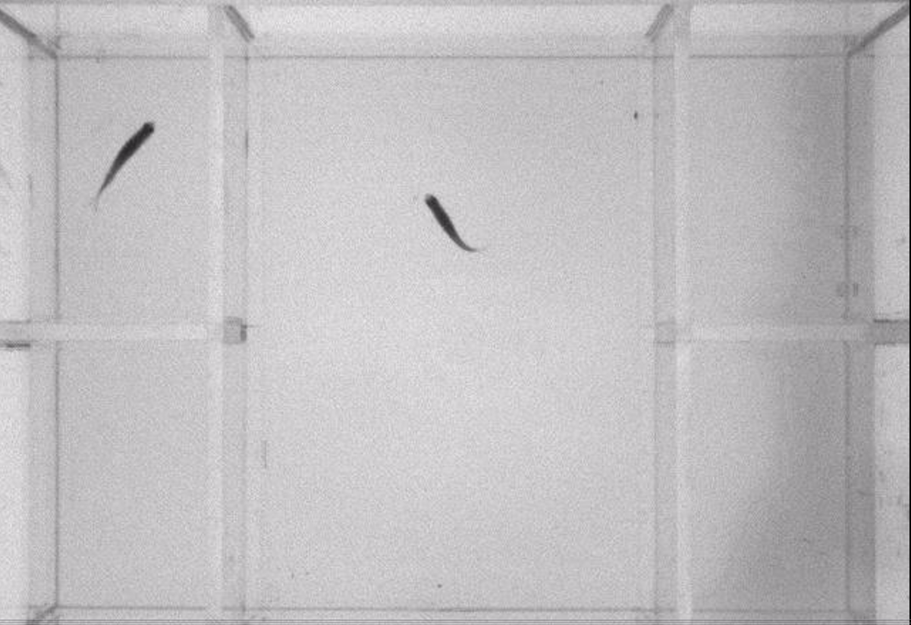
Visually-mediated social preference
Visually-mediated
social preference
Preference for
social novelty
Photo of social preference setup
Preference for
WT or ednraa
Cartoon showing social preference experiment

Slide 10
Visually-mediated social preference test: social novelty and preference
Cartoon and graphs showing results of visually-
mediated social preference test
Social interaction:
WT stimulus
Social discrimination:
WT and ednraa stimulus

Slide 11
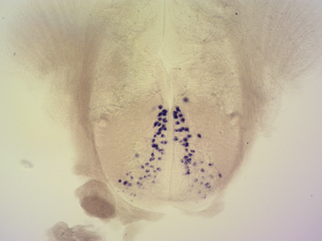
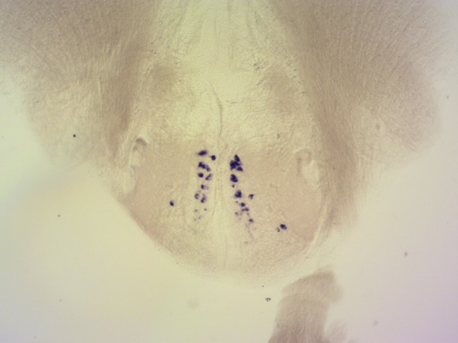
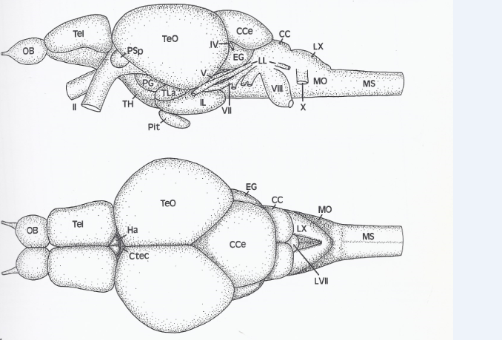
Reduction of AVP cells in adult brain
Expression of avp in larval and adult zebrafish brain
Number of cells
WT
ednraa -/-
2 dpf
avp
2 dpf
avp
AVP levels in brain
WT
ednraa -/-
4 months
avp
4 months
avp
AVP linked to control of social behaviour in many animals
Notes:
Cell counting. unpaired t test: p = 0.0030 (t = 4.022, df = 9).
Note that PPp AVP cells only develop after 8 days, so it might be to early to see a difference in the embryos shown above.
These neurons could still be here and only very small (Soojin). This means we can try and rescue with ECR6

Slide 12
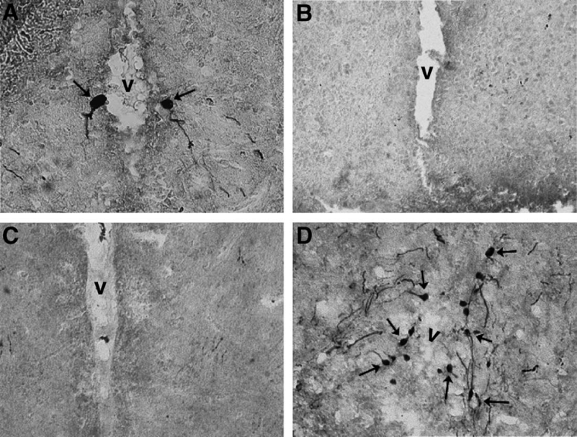
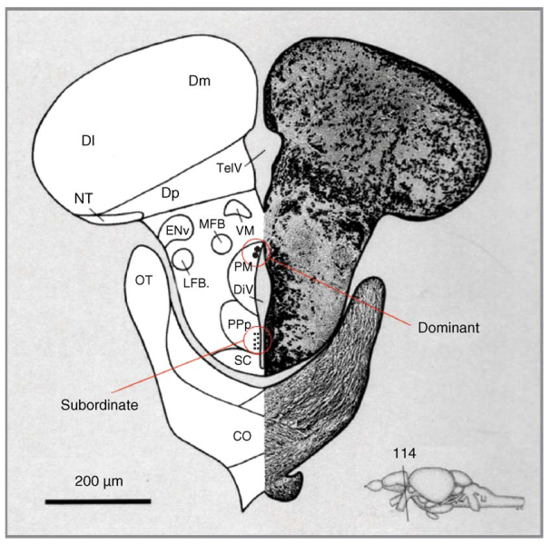
Similarity of pde and AVP phenotype
WT
pde
PM
Could be PM cells,
fits with dominant
phenotype
PPp
Photos showing AVP levels in zebrafish brain
The cells lost in pde could be magnocellular – dominant phenotype?

Slide 13
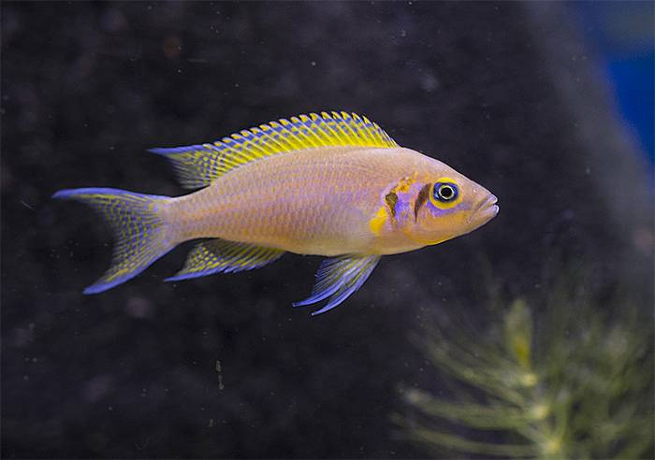
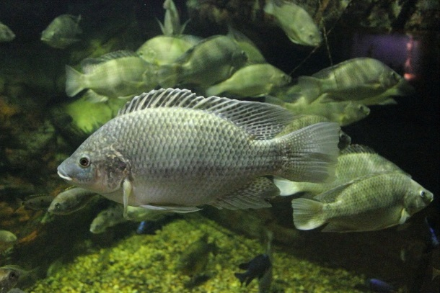
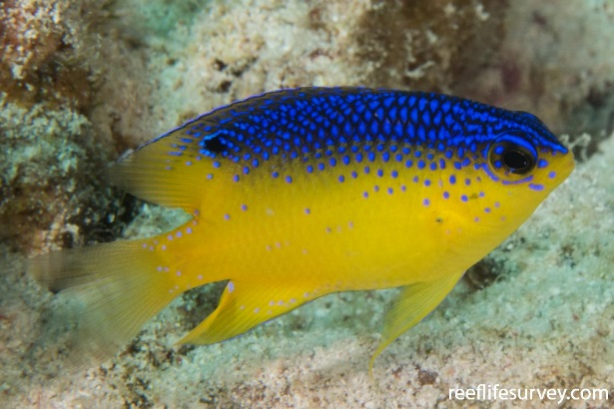
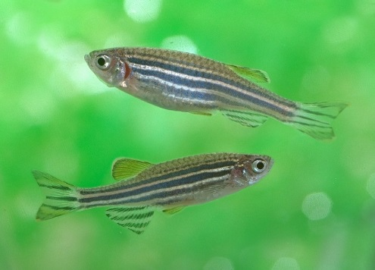
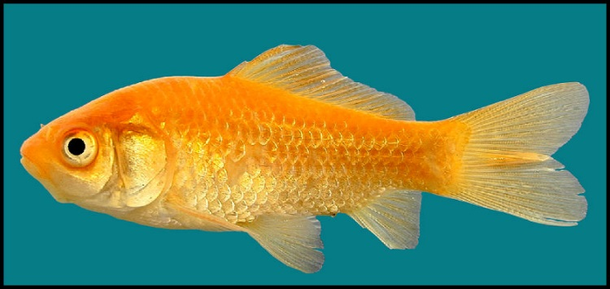
AVP controls social behaviour across vertebrate species
Lower levels of AVP in brain of dominant fish
Neolamprologous pulcher
Oreochromis mossambicus
Stegastes leucostictus
AVP injection
increases
shoaling
AVP injection
decreases
shoaling
Danio rerio
Carrasius auratus
Images show different fish species used to study AVP and social behaviour
Notes:
Daffodil cichlid; Mozambique tilapia; beaugregory damselfish

Slide 14
HPLC reveals other alterations to neurotransmitter signalling
HPLC measurements of neurotransmitters in the brain:
Increased levels of dopamine and 5-HT in the hypothalamus
(areas where AVP+ cells were altered)
Graphs showing HPLC measurements in different areas of zebrafish brain, WT and ednraa

Slide 15
Enzymes that synthesise 5-HT and DA increased in brain
Tyrosine hydroxylase (TH) – dopamine synthesis
Tryptophan hydroxylase (TPH) – 5-HT synthesis
Increased level of DA
and 5-HT due to
increased production
in brain
Graph showing qPCR measurement of gene expression levels
Notes:
Make sure it is clear that these are qPCR measurements

Slide 16
IP injection of AVP rescues the social behaviour phenotype
Graph showing social behaviour in WT and ednraa with and without AVP injection
Buy synthetic AVP and inject it into the stomach

Slide 17
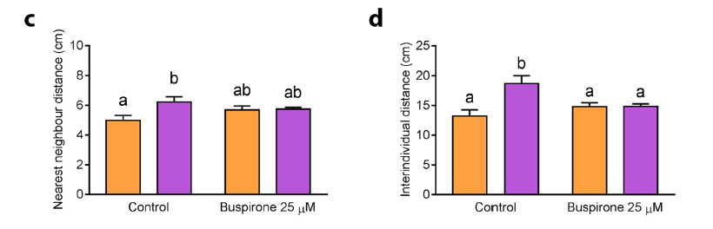
Immersion in buspirone rescues the social phenotype
Graphs showing social behaviour in WT and ednraa with and without buspirone treatment
Buspirone, is a partial 5-HT1AR agonist that decreases 5HT signalling

Slide 18
Discussion point: the social decision making network
The preoptic area sits in the middle of the SDMN: Endothelins
as a neuromodulator to alter network activity?
Cartoon showing areas of social decision making network in zebrafish brain
Decision to interact altered due to abnormal processing of stimuli?
O’Connel and Hoffman 2012

